Slide 1


Dept of AIML/
Dept of CSE(DS)

Slide 2
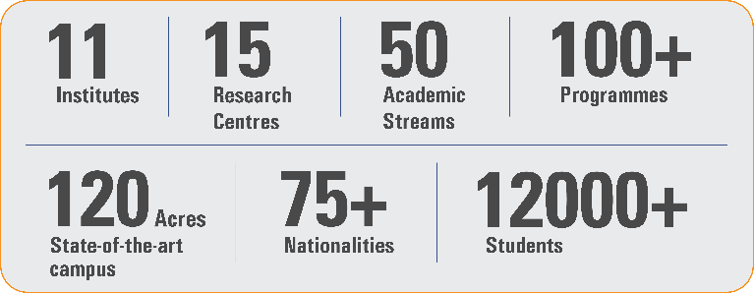
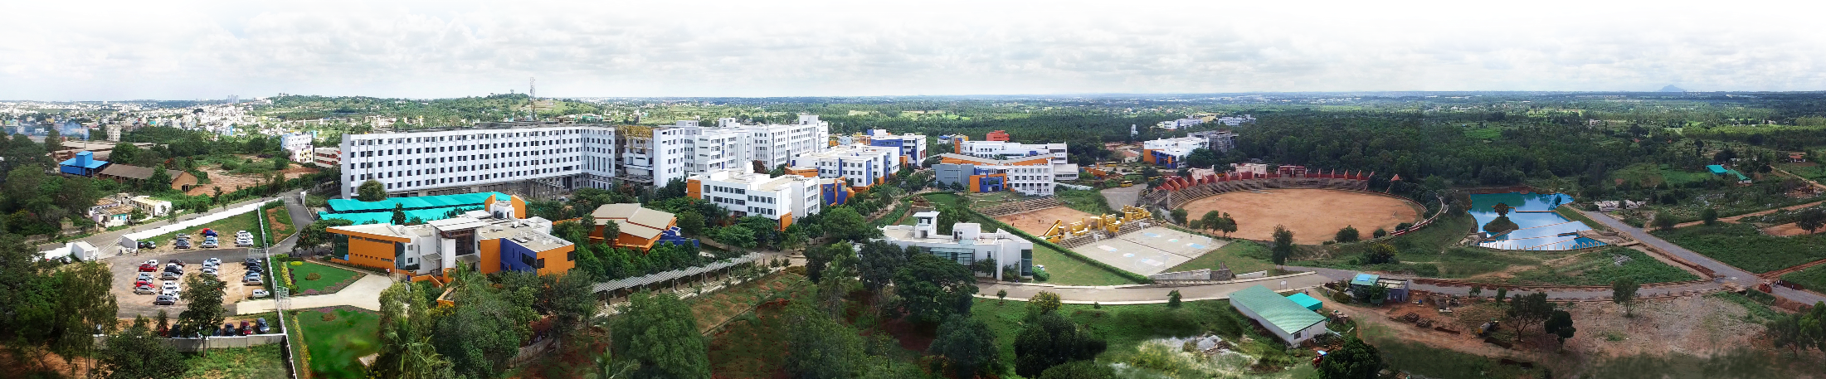
Overveiw
Acharya stands as a beacon of excellence in higher education, boasting a legacy of academic distinction since its establishment in 1990. We offer a transformative educational experience, fostering holistic development, nurturing innovation and providing world-class facilities to ensure an enriching journey for our students.
Dept of AIML/
Dept of CSE(DS)

Slide 3
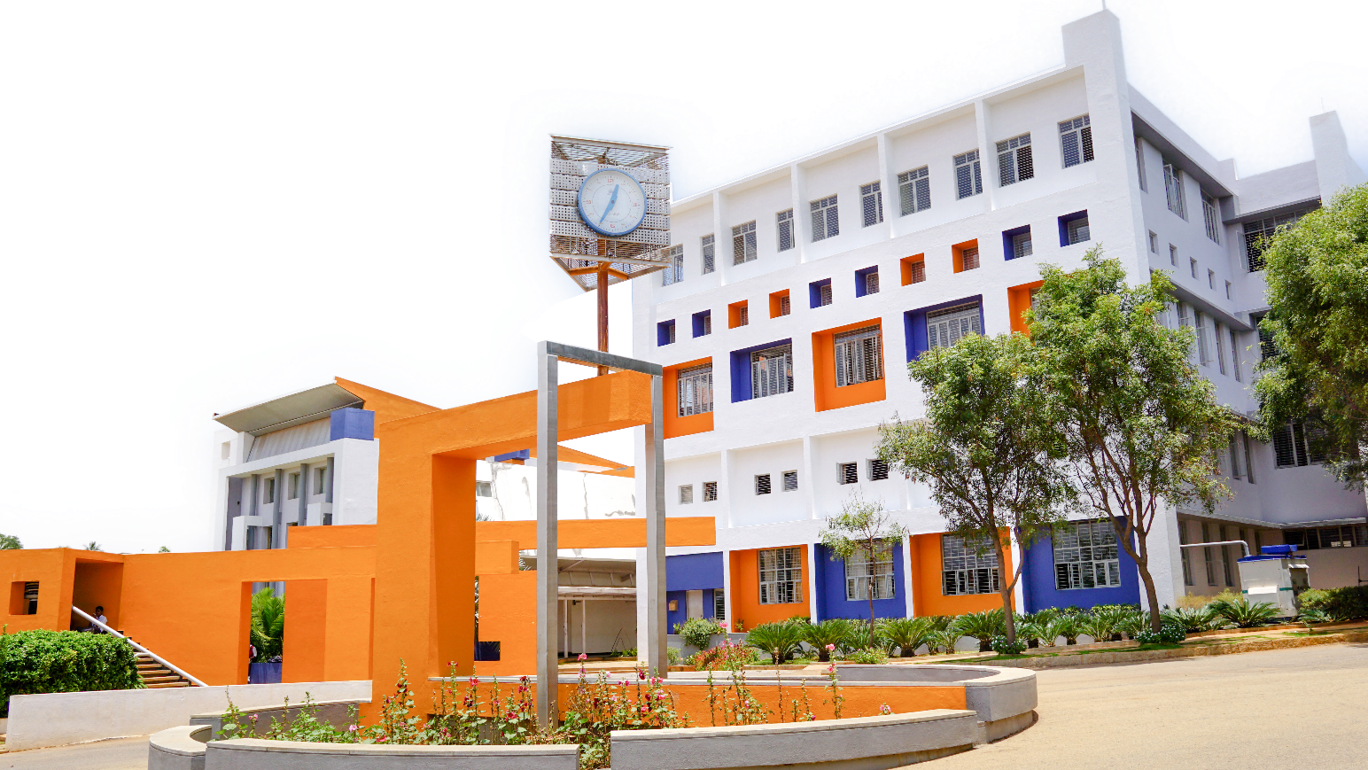
11 Institutions, Infinite Possibilities
We provide 100+ programs across 50 academic streams.
Dept of AIML/
Dept of CSE(DS)

Slide 4
PROJECT REPORT
ON
TOPIC
Subject Name:
Subject Code:
Submitted By: Submitted To:
(Student Name with USN) Ms. Surbhi
Dept of AIML/
Dept of CSE(DS)

Slide 5
Heading
Important
Make the first slide a Table of Contents
Each slide must use the same template.
Don’t add too much content per slide.
Write the content in points.
Make heading as 28, Bold, Times New Roman; sub heading as 24, Bold, Times New Roman and rest of the content as as 20, Times New Roman.
Alignment must be Justified.
Use your creativity for better presentation.
Dept of AIML/
Dept of CSE(DS)

